Slide 1


Stereo Projection
Using Primal-Dual Variational Method
Course :: GPU Programming in Computer Vision (WS2013/14)
Team :: Warp64 (group 9)
Adviser :: Mohamed S.
Members :: Baishya S. (03649393) Debnath S. (03649492 )and Karthik A. ()
“You must be the change you wish to see in the world.” ― Mahatma Gandhi

Slide 2
Introduction
“.. You can't connect the dots looking forward; you can only connect them looking backwards.. ” ― Steve Jobs

Slide 3
Aim
Implementation of a Computer Vision algorithm with the goal focused on performance measure and comparing memory types.
And a little bit of theory..

Slide 4
Contents
Stereo Projection
Example
Theory
Implementation
Result and Performance
GUI and Demo

Slide 5
EXAMPLES
“We are apt to forget that children watch examples better than they listen to preaching.” ― Roy L. Smith

Slide 6
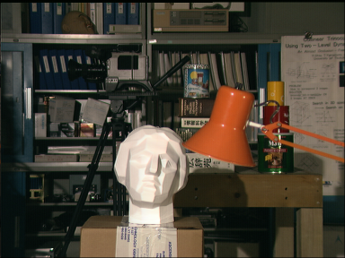
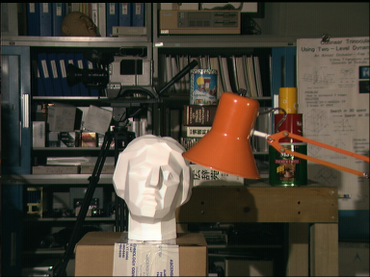
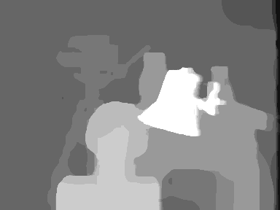
Example 1: STATUE IMAGE
Left Image
Right Image
Depth image

Slide 7
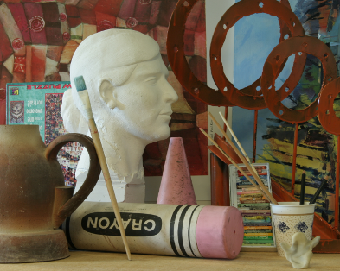
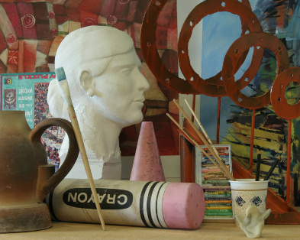

Example 2: Man Image
Left Image
Right Image
Depth image

Slide 8
THEORY
“If the facts don't fit the theory, change the facts.” ― Albert Einstein

Slide 9
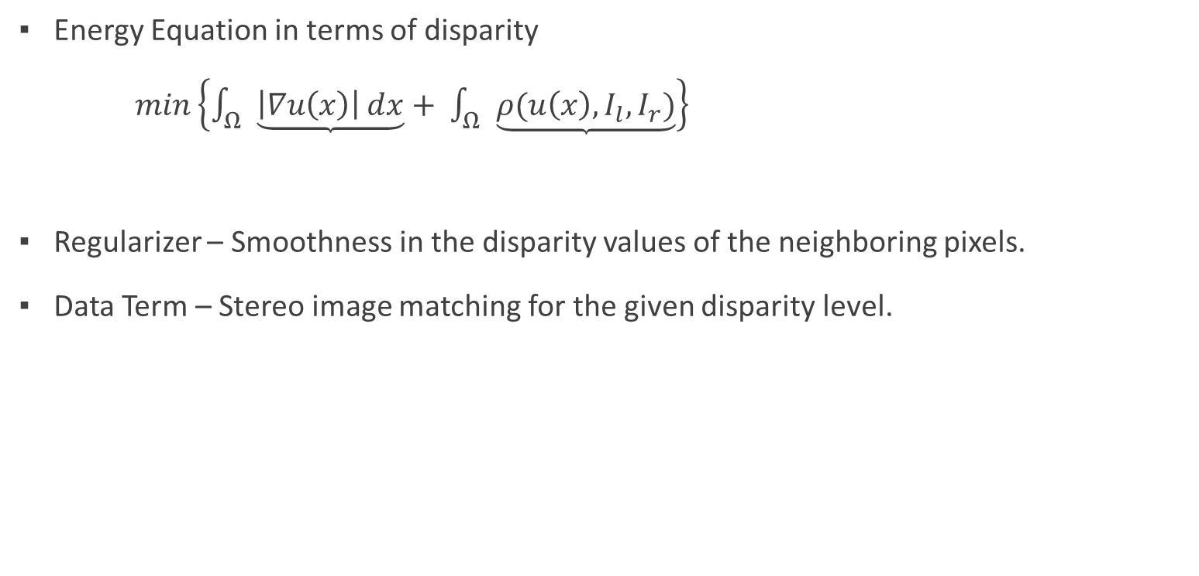
Formulation: Variational Method
Energy Equation in terms of disparity
$min\left\{\int_{Ω}{\underbrace{\left|∇u\left(x\right)\right|ⅆx}}+ \int_{Ω}{\underbrace{ρ(u\left(x\right), I_{l}, I_{r})}}\right\}$
Regularizer – Smoothness in the disparity values of the neighboring pixels.
Data Term – Stereo image matching for the given disparity level.
Regularizer
Data Term

Slide 10
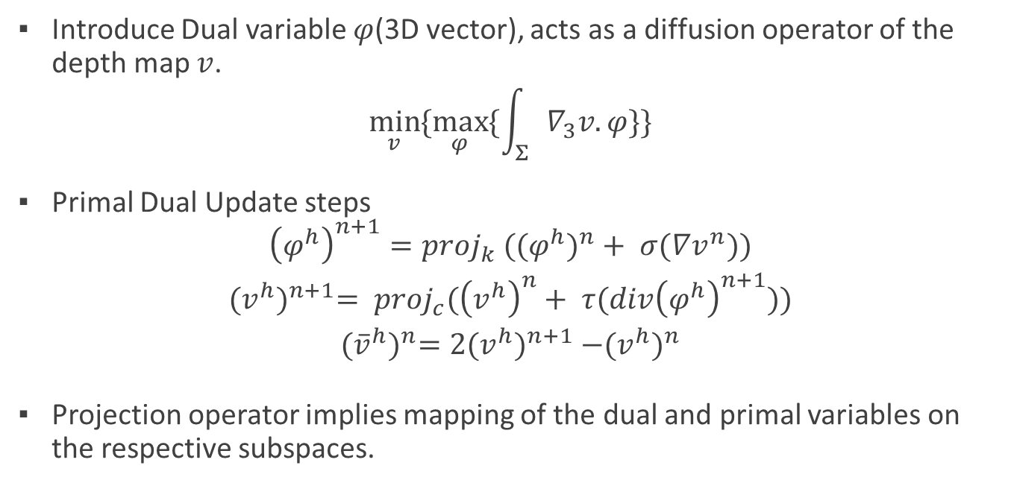
Primal Dual Formulation
Introduce Dual variable $φ$(3D vector), acts as a diffusion operator of the depth map $v$.
$$\min_{v}{\{\max_{φ}{\{\int_{Σ}{∇_{3}v.φ}\}}\}}$$
Primal Dual Update steps
$${\left(φ^{h}\right)}^{n+1}={proj}_{k} ({{(φ}^{h})}^{n}+ σ(∇v^{n}))$$
$${(v^{h})}^{n+1}= {proj}_{c}({\left(v^{h}\right)}^{n}+ τ(div{\left(φ^{h}\right)}^{n+1}))$$
$${({\overline{v}}^{h})}^{n}=2{(v^{h})}^{n+1} −{(v^{h})}^{n}$$
Projection operator implies mapping of the dual and primal variables on the respective subspaces.

Slide 11


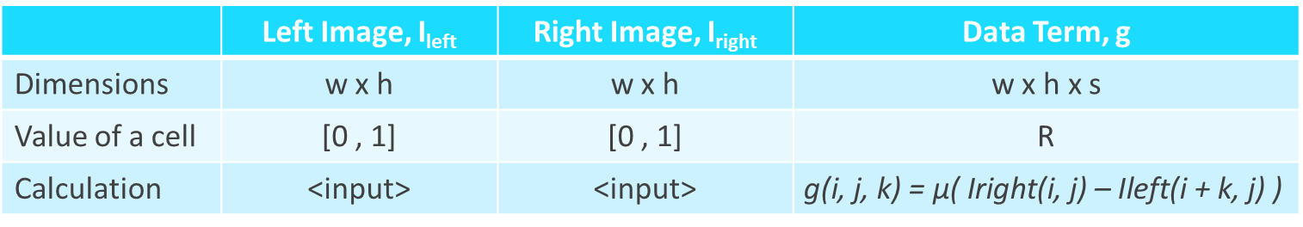
FORMULATION: VISUALISATION
 | Left Image, I_{left} | Right Image, I_{right} | Data Term, g
Dimensions | w x h | w x h | w x h x s
Value of a cell | [0 , 1] | [0 , 1] | R
Calculation | <input> | <input> | $$\text{g}\text{(}\text{i}\text{, }\text{j}\text{, }\text{k}\text{) = }\text{μ}\text{( }\text{Iright}\text{(}\text{i}\text{, }\text{j}\text{) – }\text{Ileft}\text{(}\text{i}\text{ + }\text{k}\text{, }\text{j}\text{) )}$$
where s = slice depth
initialization

Slide 12


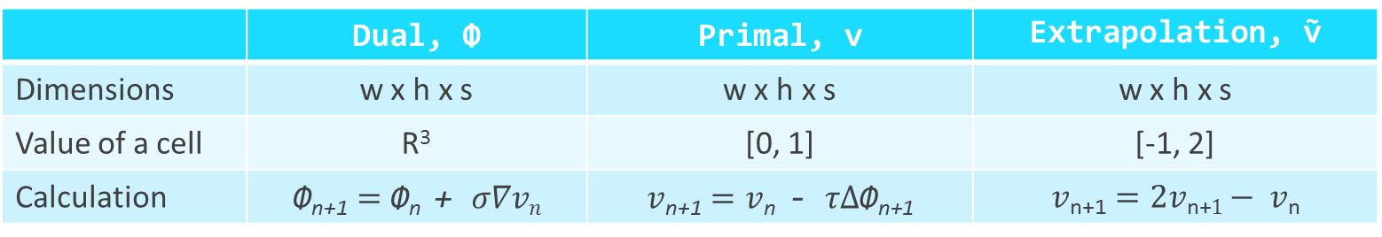
FORMULATION: VISUALISATION
 | Dual, Φ | Primal, v | Extrapolation, ṽ
Dimensions | w x h x s | w x h x s | w x h x s
Value of a cell | R³ | [0, 1] | [-1, 2]
Calculation | $$\text{Φ}\text{n}\text{+1}=\text{Φ}\text{n} \text{+ }σ∇vn$$ | $$v\text{n}\text{+1}=v\text{n} \text{− }τ∆\text{Φ}\text{n}\text{+1}$$ | $$v\text{n}\text{+1}=2v\text{n}\text{+}1− v\text{n}$$
until convergence

Slide 13
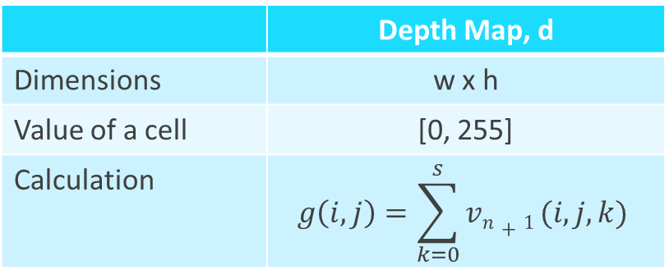
FORMULATION: VISUALISATION
 | Depth Map, d
Dimensions | w x h
Value of a cell | [0, 255]
Calculation | $$g\left(i, j\right)=\sum_{k=0}^{s}{vn+1 (i, j, k)}$$

Slide 14
Implementation
“A good idea is about ten percent and implementation and hard work, and luck is 90 percent.” ― Guy Kawasaki

Slide 15
IMPLEMENTATION: Kernels
calc_data_term(I_{left}, I_{right}) -> g
Compute sliced difference in intensity
update_dual(g, v_{n}) -> Φ_{n+1}
Update the dual variable using gradient accent on current primal variable
n steps
update_primal_and_extrapolate(g, Φ_{n+1})
-> v_{n+1,} ṽ_{n+1}
Update the primal variable using gradient descent on updated dual variable and also extrapolate primal variable
calc_depth_map(v_{n+1}) -> depth_image
Sum along z for each (x, y) of primal to get depth map

Slide 16
Implementation: GPU Techniques
Stereo Projection
2D grid of threads
Global Memory
Texture Memory
3D grid of Threads
Global Memory
Pitch Allocation
Texture Memory
Shared Memory
Texture Memory
Shared Memory

Slide 17
RESULTS and performance
“Insanity: doing the same thing over and over again and expecting different results.” ― Albert Einstein

Slide 18
RESULTS: GPU v/s CPU

Slide 19
RESULTS: RUN TIME RESULTS

Slide 20
Results: CONVERGENCE

Slide 21
RESULTS: KERNEL AVERAGE RUNTIME

Slide 22
RESULTS: TYPES COMPARISONS

Slide 23
Results: COMPOSITION OF KERNELS

Slide 24
Results: CONVERGENCE (HACK)

Slide 25
GUI and DEMO
“What is it indeed that gives us the feeling of elegance in a solution, in a demonstration?” ― Henri Poincare

Slide 26
To Sum Up
Great performance boost compared to CPU.
We have seen different types of GPU techniques.
In cc >= 2.x, texture does not give a big boost.
Pitch allocation always improves performance (except for already pitched memory).
Shared Memory is useful in case of O(n²) access.
In convex problems, initialization hacks may lead to faster convergence.

Slide 27

References
[1] Pock T., Cremers D., Bischof H., Chambolle A., Global Solutions of Variational Models with Convex Regularization
[2] Variational Methods, TUM Class Lectures
[3] CUDA Programming GUIDE

